Slide 1
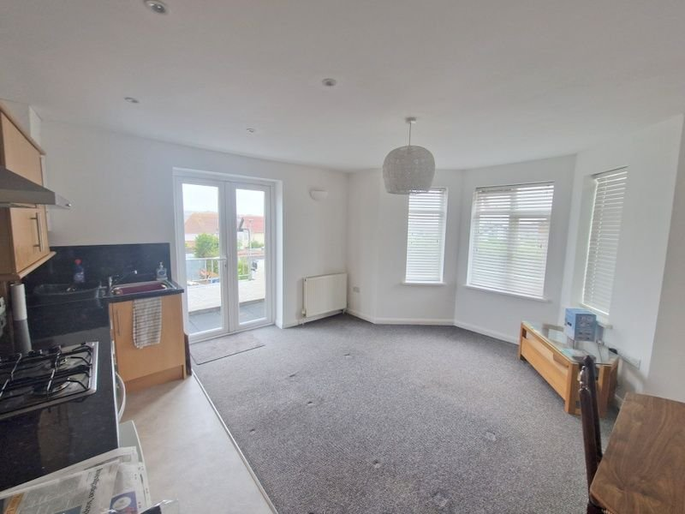
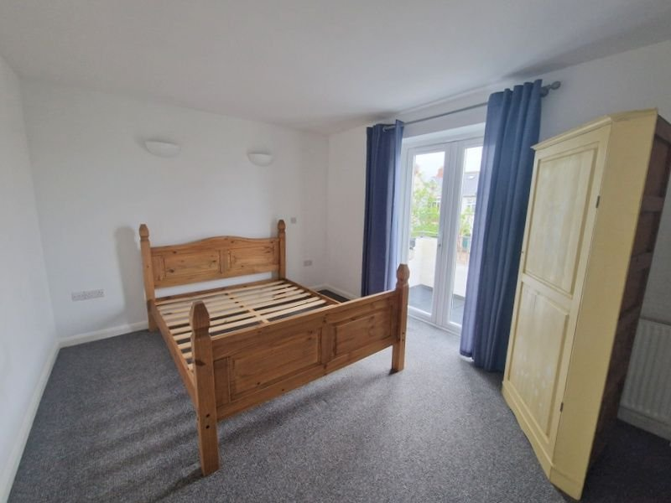
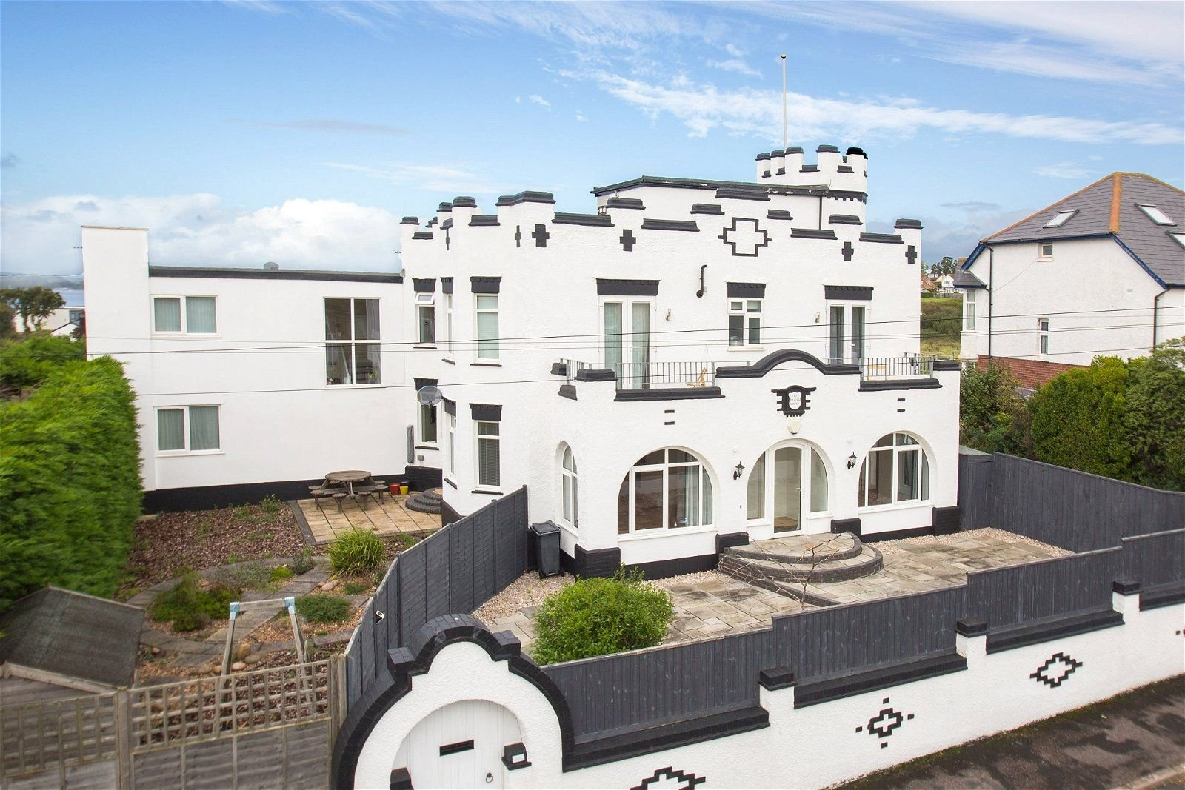
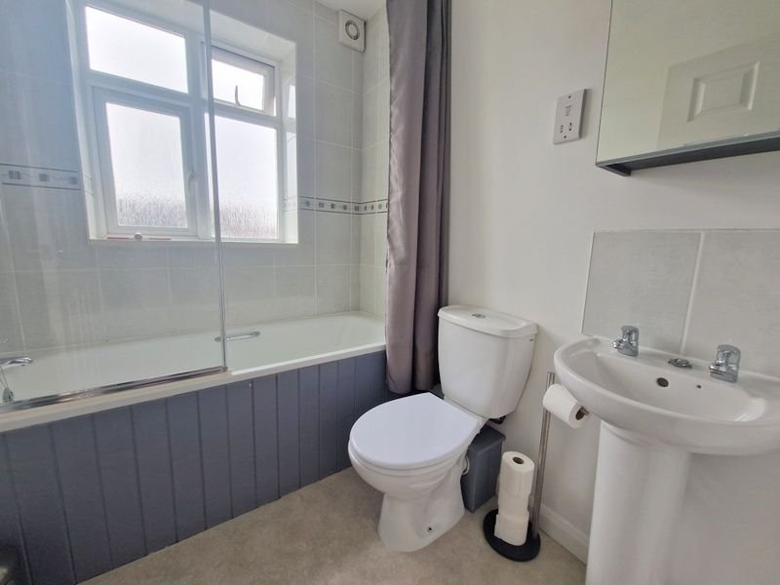
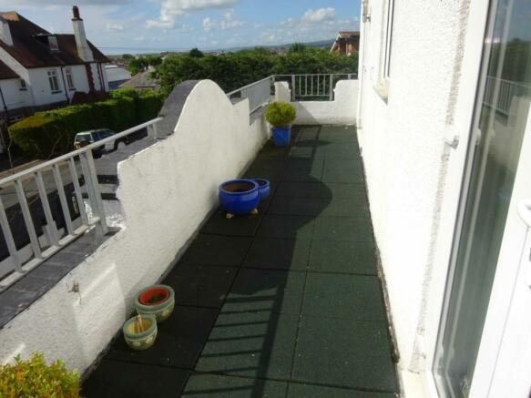
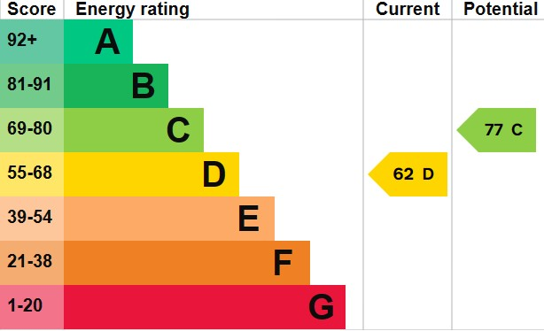
www.pennys.net
Flat 5 Tower House, 23 Belle Vue road, Exmouth, EX8 3DP
GUIDE PRICE £189,950
TENURE Share Freehold Freehold
PENNYS ESTATE AGENTS
2 Rolle House, Rolle Street, Exmouth, Devon, EX8 2SN
Tel: 01395 264111 EMail: help@pennys.net
A Well Presented First Floor Apartment Forming Part Of A Distinctive Building Ideally Situated Close To Amenities, Cycle Path, Town Centre And Sea Front.
Pleasant outlook Towards The Estuary • Reception Hall • Open Plan Kitchen/Living Room •
Double Bedroom • Bathroom/WC •
Large Balcony • Allocated Parking Space •
Double Glazed Windows And Gas Central Heating •
Super Permanent Or Holiday Home Retreat • No Onward Chain •
Pennys Estate Agents Limited for themselves and for the vendor of this property whose agents they are give notice that:- (1) These particulars do not constitute any part of an offer or a contract. (2) All statements contained in these particulars are made without responsibility on the part of Pennys Estate Agents Limited. (3) None of the statements contained in these particulars are to be relied upon as a statement or representation of fact. (4) Any intending purchaser must satisfy himself/herself by inspection or otherwise as to the correctness of each of the statements contained in these particulars. (5) The vendor does not make or give and neither do Pennys Estate Agents Limited nor any person in their employment has any authority to make or give any representation or warranty whatever in relation to this property.

Slide 2
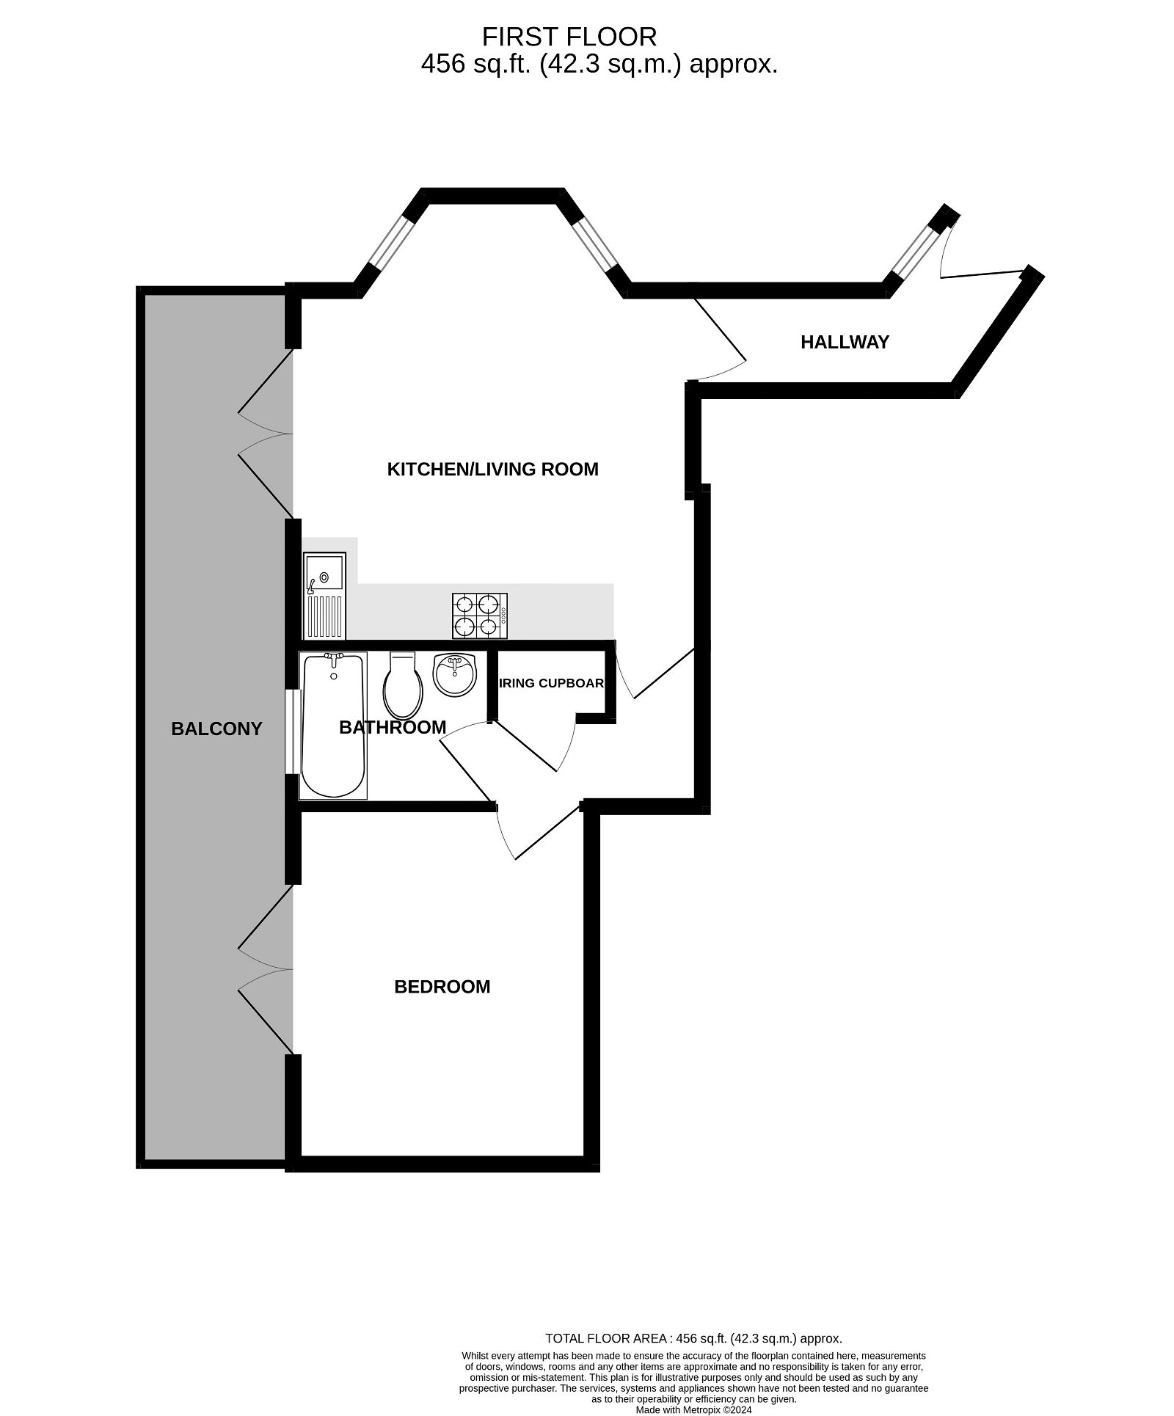
Flat 5 Tower House, 23 Belle Vue Road, Exmouth EX8 3DP
THE ACCOMMODATION COMPRISES: With entry door intercom system; stairs to: FIRST FLOOR LANDING: Own front door to: RECEPTION HALL: Door entry phone; double glazed window; radiator; electric consumer unit; door to: OPEN PLAN KITCHEN/LIVING ROOM: 4.72m x 4.39m (15'6" x 14'5") into double glazed bay window. With views towards the estuary; two radiators; double glazed doors onto sun terrace; TV point; telephone point. KITCHEN is fitted with pattern work tops with matching splashbacks; inset single drainer sink unit with mixer tap; cupboards and drawers with appliance space beneath work tops; inset four ring gas hob, built in oven and extractor over; wall mounted cupboards. INNER HALLWAY: Utilities cupboard with plumbing for automatic washing machine; radiator. BEDROOM: 3.78m x 3.15m (12'5" x 10'4") Double glazed doors to terrace; wall lighting; radiator. BATHROOM: 2.06m x 1.7m (6'9" x 5'7") Bath with shower over; shower screen; WC; pedestal wash hand basin; shaver socket; mirror fronted medicine cabinet; chrome heated towel radiator; ceiling spot lighting. OUTSIDE: Allocated parking space; lovely lawned communal gardens.
TUNURE: The property is held on a 999 year lease from 2007 and also enjoys 1/8th share of the Freehold. Service charges: £110 per month.

